Slide 1
XTrace 2 – The innovative X-ray source for micro-XRF analysis on SEM
Bruker Nano Analytics
info.bna@bruker.com
Innovation with Integrity

Slide 2
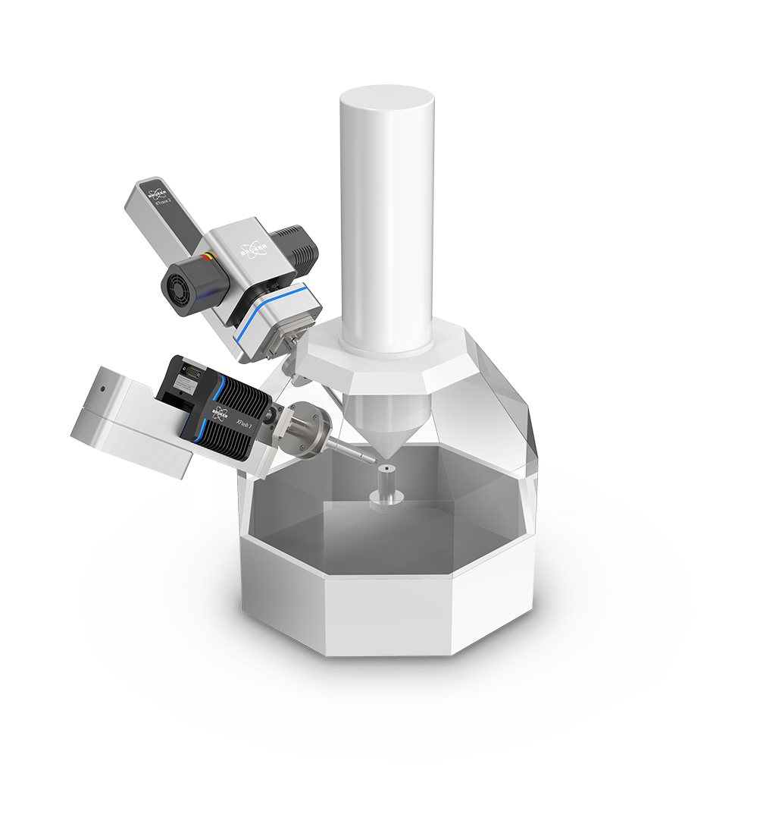
QUANTAX Micro-XRF System – Key facts
Bruker Nano Analytics Division
10 ppm
detection limit
Trace element analysis due to a low spectral background
1 nm – 40 µm
layer thickness range
Analysis of thin films and multi-layered structures
Minimal sample preparation
No coating required, no charging effects

Slide 3
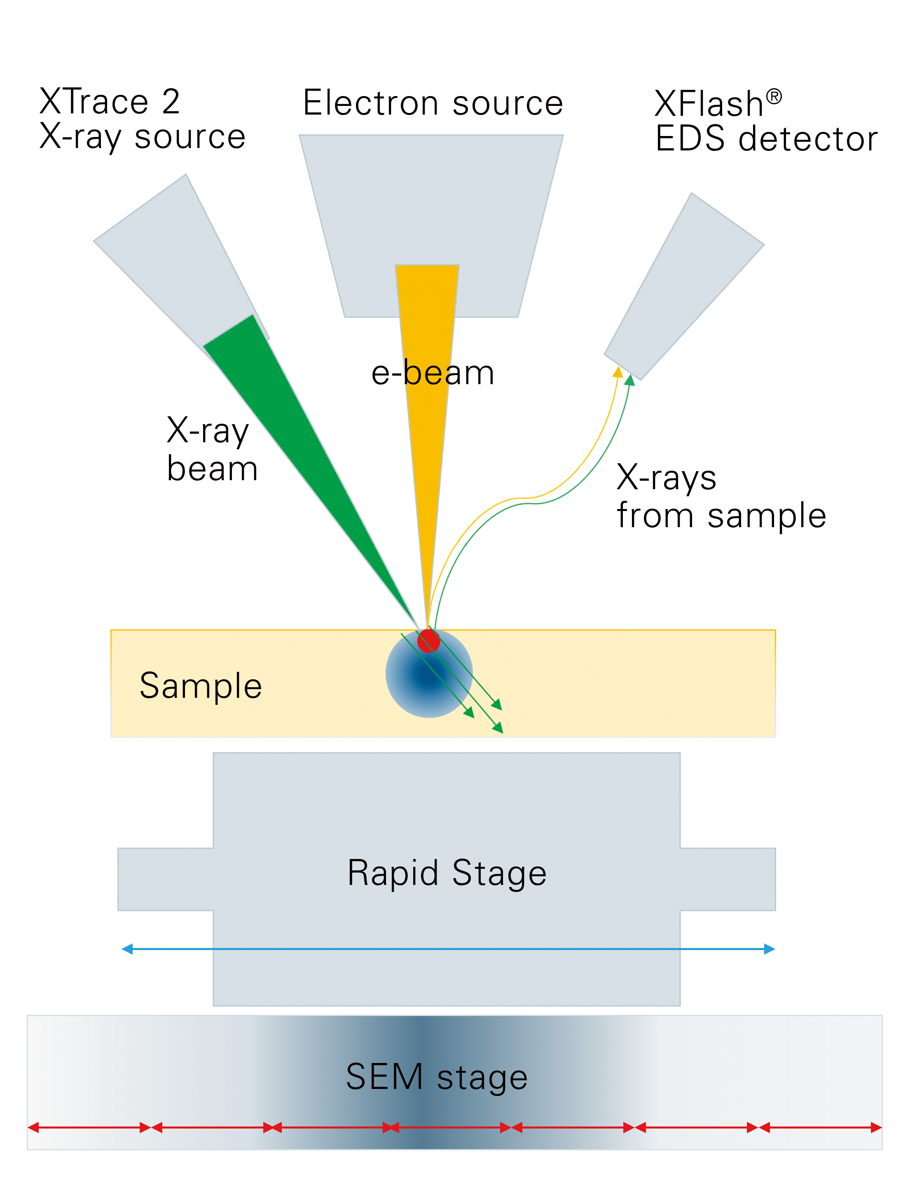
QUANTAX Micro-XRF System – Expand your SEM analytical capabilities
Bruker Nano Analytics Division
Micro-XRF on SEM as a complementary analytical technique to EDS analysis
Micro-X-ray Fluorescence (micro-XRF) spectroscopy is a non-destructive analytical technique that can be used alongside conventional Energy Dispersive Spectroscopy (EDS) on a Scanning Electron Microscope (SEM).
Micro-XRF on SEM, also known as SEM-XRF, empowers the SEM with a range of new analytical capabilities, using the same EDS detector already installed on the SEM.
Micro-XRF on SEM will convert the standard SEM to a dual beam source system (e-beam + photon beam), which can be activated either independently or simultaneously to obtain the benefits of each excitation method.

Slide 4
QUANTAX Micro-XRF System – Expand your SEM analytical capabilities
Bruker Nano Analytics Division
Benefits of using a photon beam source on a SEM
Non-destructive analytical technique: No heating or charging on e-beam sensitive samples
Minimal sample preparation: No coating or polishing requried
Trace element detection limits: Due to the low background (high signal-to-noise ratio), detection limits as low as 10 ppm are possible (element and matrix dependent)
Wide elemental identification range: Majority of elements in the periodic table can be identified, from carbon (Z = 6) to uranium (Z = 92)
High energy line detection: Extended X-ray spectral range (up to 40 keV)
Large area mapping: Sample size for elemental mapping can be up to the SEM sample chamber size: micrometer scale measurement over centimenter scale sample size
Multi-layered sample analysis: The larger depth of X-ray excitation allows for the characterization of multilayer systems

Slide 5
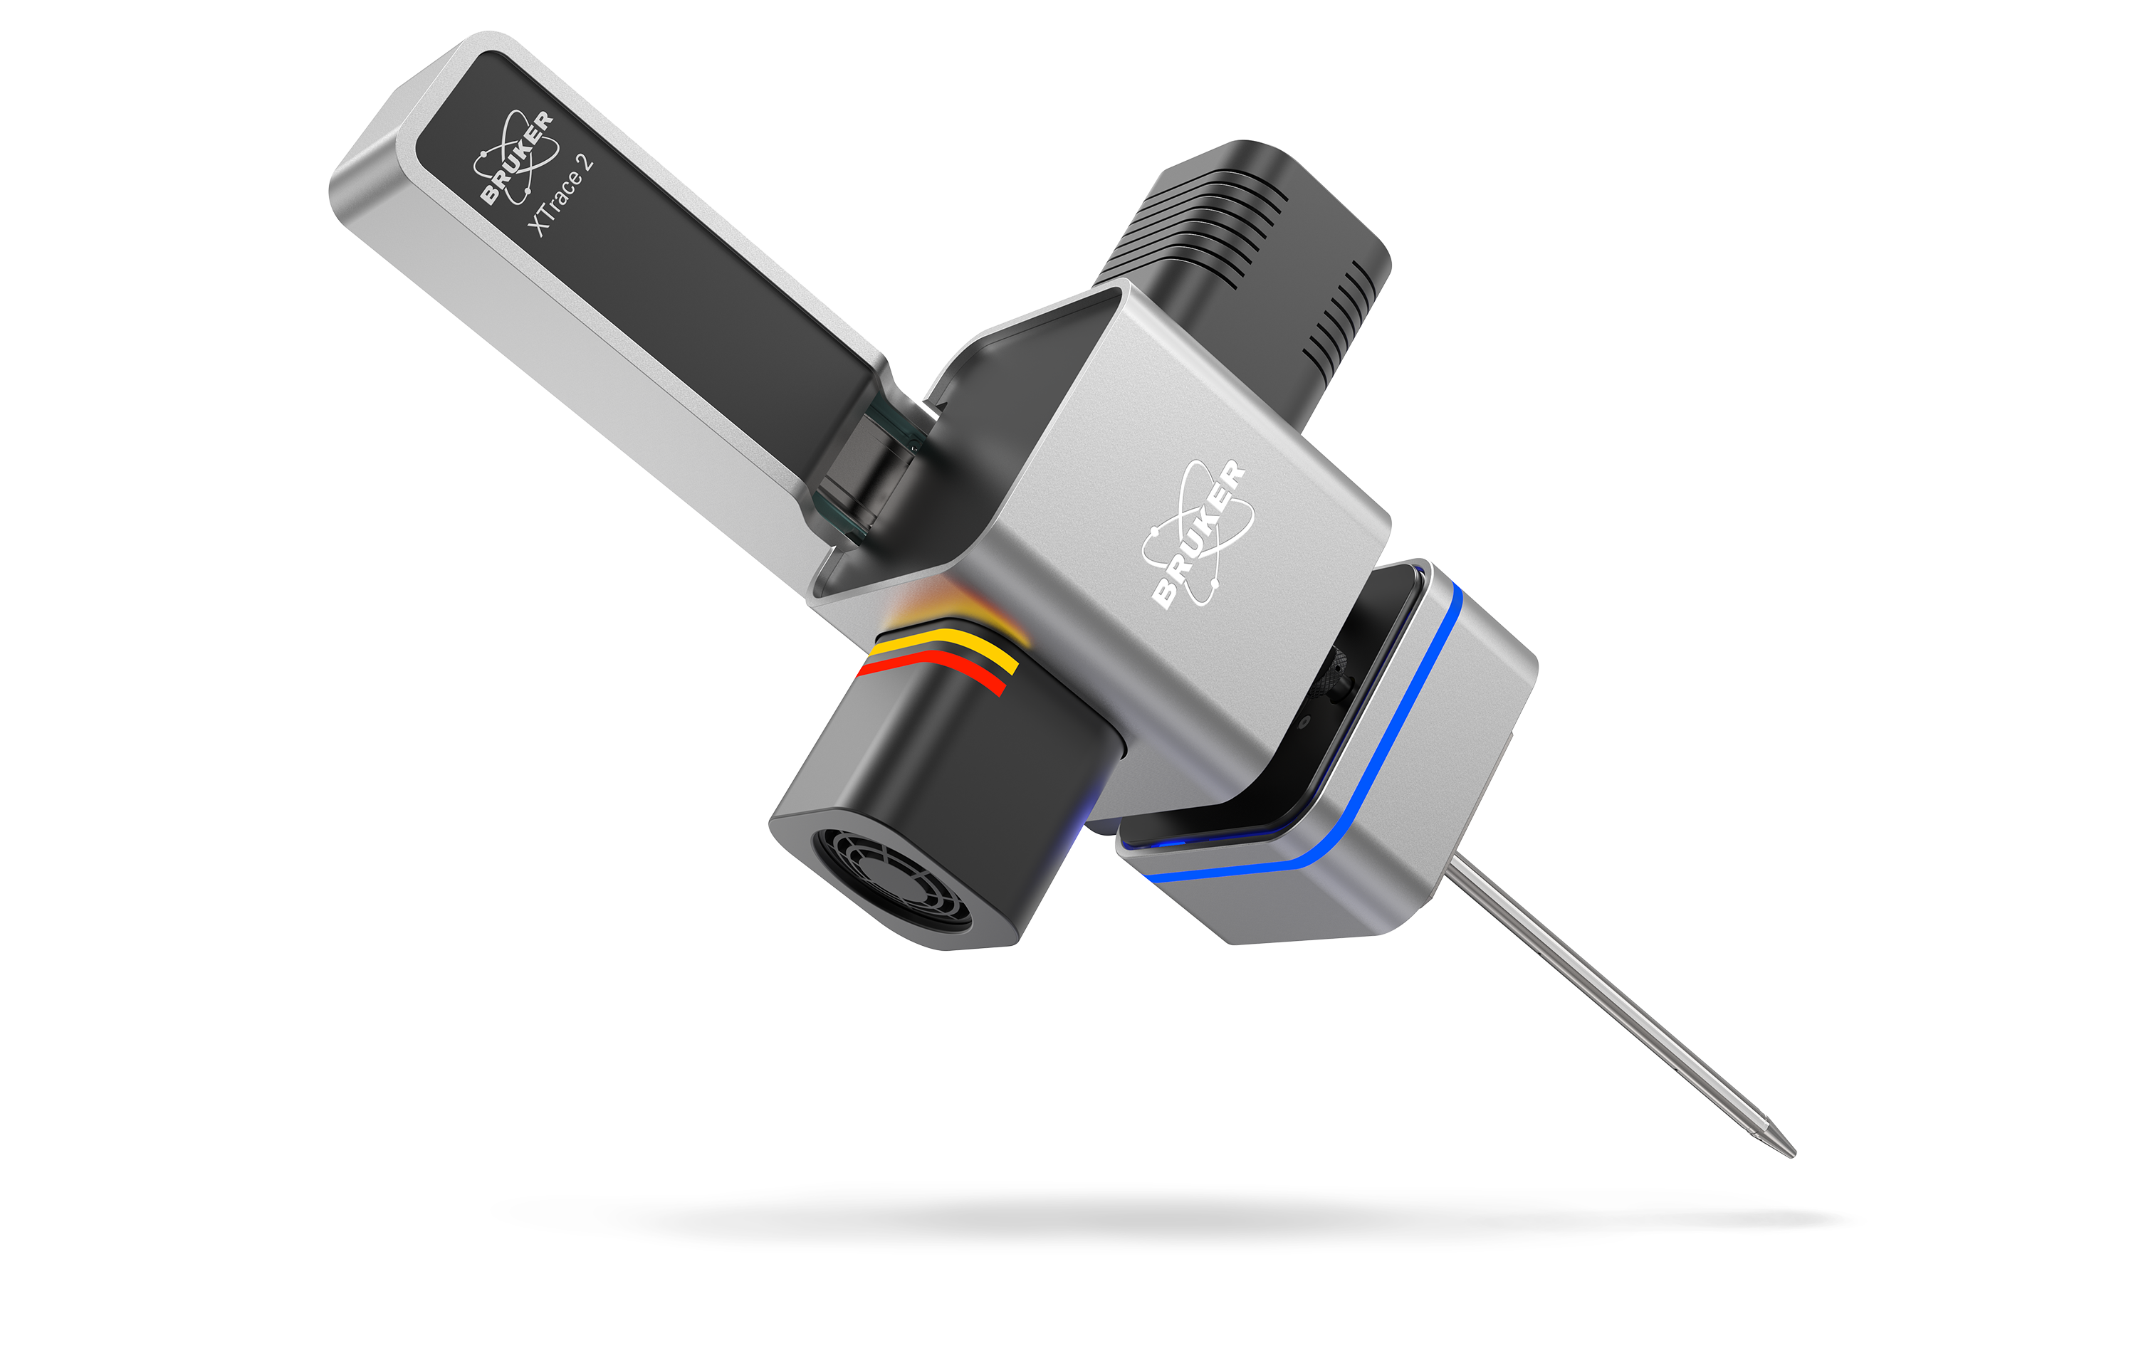
XTrace 2 – Next generation X-ray source for micro-XRF on SEM
Bruker Nano Analytics Division
New tube housing design including 50 W X-ray tube, motorized primary wheel with filters and AMS
Motorized linear stage
Active light identification for measurement running and/or stage movement
HV + Shutter Status LED
Noised reduced (floating suspension) fan

Slide 6
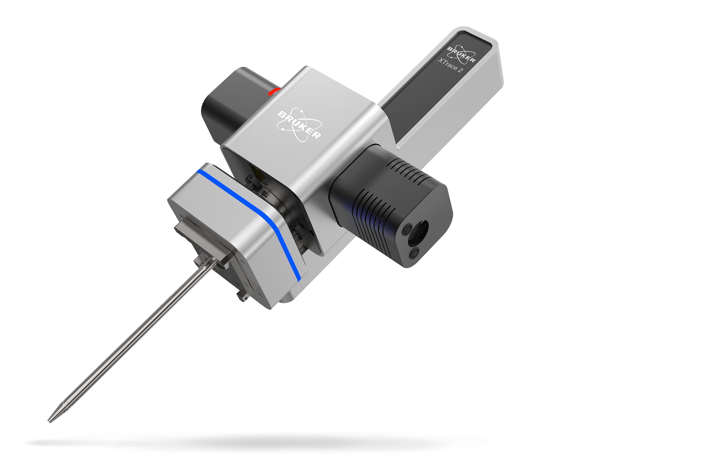
XTrace 2 – Key facts
Bruker Nano Analytics Division
50 W
X-ray tube power
Sample analysis at high count rates for reduced acquisition time
AMS & Filters
Scan topographic samples with enhanced depth of field and select from six primary filters for further background reduction and improved element detection
Auto source retraction mode
Automatically and safely retract the X-ray optic source

Slide 7
XTrace 2 – Advanced X-ray source for micro-XRF on SEM
Bruker Nano Analytics Division
XTrace 2 is the next-generation X-ray source in the QUANTAX micro-XRF system. This new and innovative X-ray source enables fast micro-XRF spectral acquisition with high-resolution XRF data. Advanced features include:
High tube power: Generate X-rays at high energies of 50 kV and beam currents of 1000 µA for a high-count rate allowing accurate elemental data to be collected quickly and efficiently.
Automatically switch between 6 primary filters to reduce measurement background and precisely acquire low-count peaks.
Scan topographic samples with high resolution XRF signal intensity using an Aperture Management System (AMS) that keeps the image in focus across variable measurement heights.
Analyze inhomogeneous and/or irregular samples using FlexiSpot mode, allowing spectral measurements using a small or large spot size.
Improved equipment lifetime with the automatic tube warm-up procedure and motorized linear stage with automatic source retraction (measuring and parking position).
Software capability for saving and correlating micro-XRF and e-beam measurements.

Slide 8
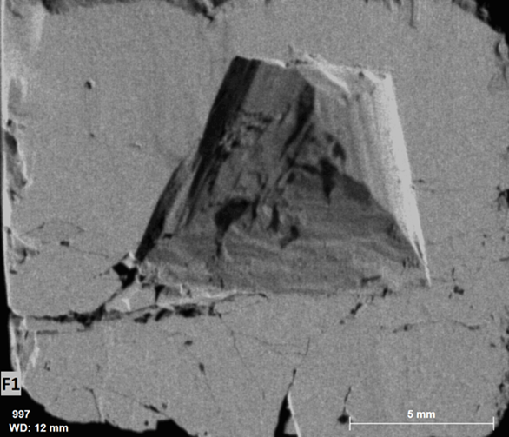
XTrace 2 – Aperture Management System (AMS) feature
Bruker Nano Analytics Division
XTrace 2 is equipped with a patented Aperture Management System (AMS) to retain measurement resolution over a certain depth 3 range, allowing the examination and visualization of topographical samples. When carrying out standard micro-XRF analysis on SEM a 4 mm deviation from the working distance results in a ≈ 10 times increase in the spot size, i.e., a 10 times reduction in resolution.
The AMS keeps the optic in focus at varying working distances by increasing the depth of field. This means that any reduction in resolution due to deviations in the working distance is minimized, facilitating the high-resolution elemental mapping of topographical samples and their 3D features.
The AMS feature allows to scan even samples with topography in the SEM. This example of a pyrite shows a micro-XRF map collected with no AMS (left) and with AMS (500 µm) (right). Mapping the sample by using the AMS can even resolve the structures of the sample depth at 2.1 mm.
Pyrite FeS₂ - No AMS
Pyrite FeS₂ - AMS 500 µm

Slide 9
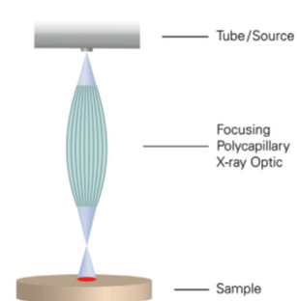
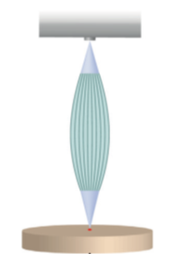
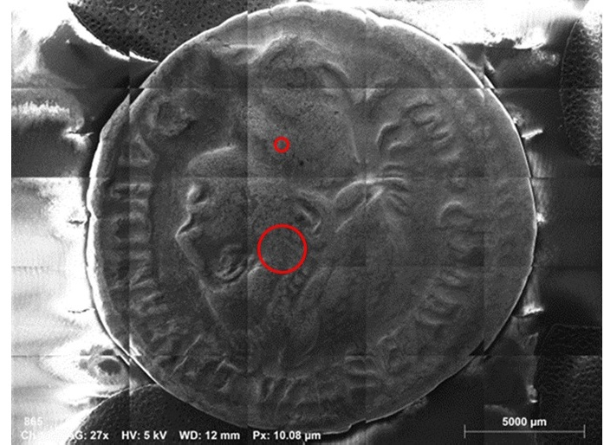
XTrace 2 – FlexiSpot feature
Bruker Nano Analytics Division
FlexiSpot allows measurements at different spot sizes, ranging from 35 µm (standard optic spot size) to 500 µm and even beyond. Large spot sizes are used for overall analysis, while small spot sizes are used for the analysis of specific features.
FlexiSpot works by retracting the X-ray source, allowing the X-ray optic to be defocused out of the nominal optical working distance.
The spot size is selected in the ESPRIT software via an automated process.
Multiple individual spot sizes can be selected.
Measuring at larger spot sizes allows more accurate quantification of inhomogeneous and irregular shaped samples as well as samples with uneven surfaces. A large spot area provides more representative excitation in just one measurement.
35 µm spot
Defocused X-ray spot
35 µm spot
200 µm spot
Small (35 µm) and large (200 µm) X-ray spots on a sample.

Slide 10
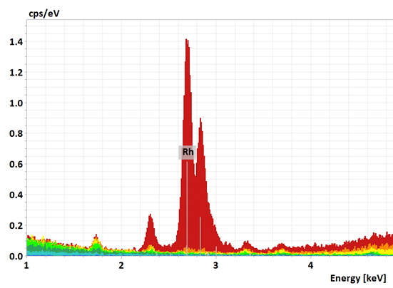
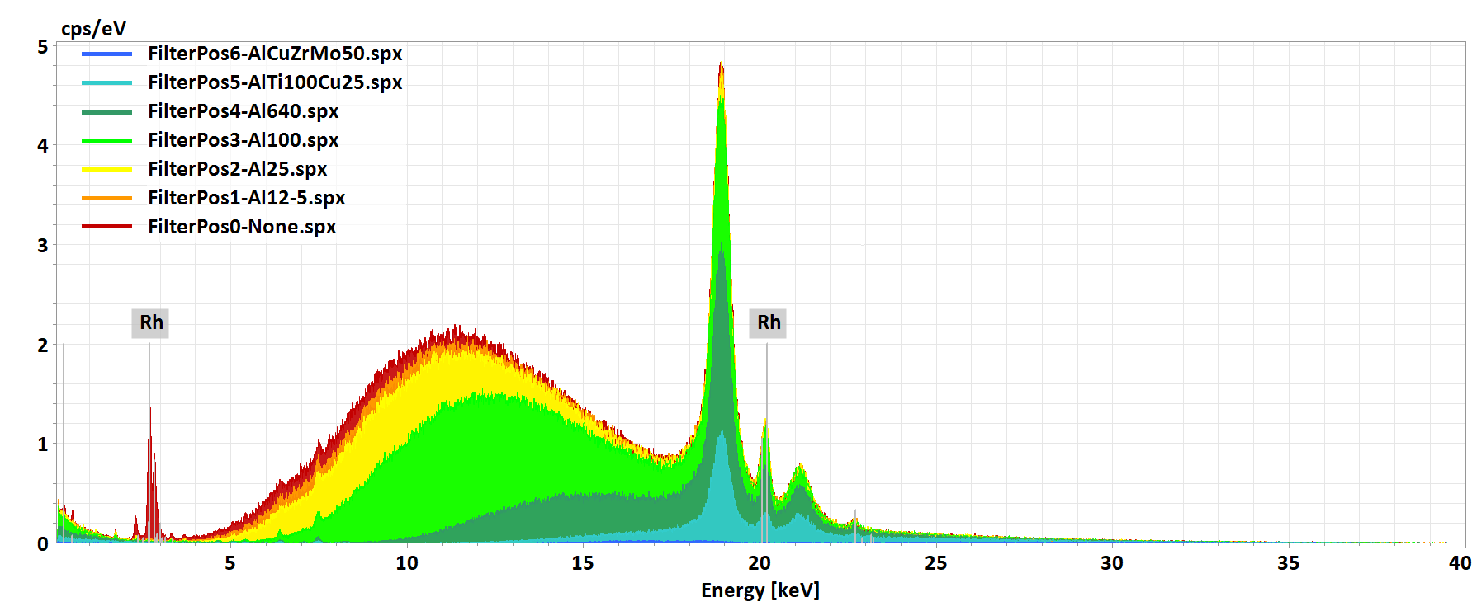
XTrace 2 – Motorized wheel with 6 primary filters and 2 AMS apertures
Bruker Nano Analytics Division
The new XTrace 2 has space for nine different options within the wheel, located between the X-ray tube and polycapillary optic, allowing further background reduction for each individual X-ray energy region.
Position "0" is left blank and is used for normal unfiltered analysis, whereas positions 1 to 6 are reserved for primary filters and positions 7 and 8 AMS apertures. Switching between positions is automatic via software control.
9 position filter wheel
Effect of different primary filters on an XRF excitation spectrum. All filter thicknesses are given in micrometers, e.g., Al12_5 means 12.5 µm aluminum filter.
Notes:
Which filter for which element region?
Al 12.5 um up to 3 keV
Al 25 um up to 4 keV
Al 100 um up to 6 keV
Al 640 um up to 9 keV
AlTi100Cu25 um up to 11 keV
AlCuZrMo 50 um up to 20 keV

Slide 11
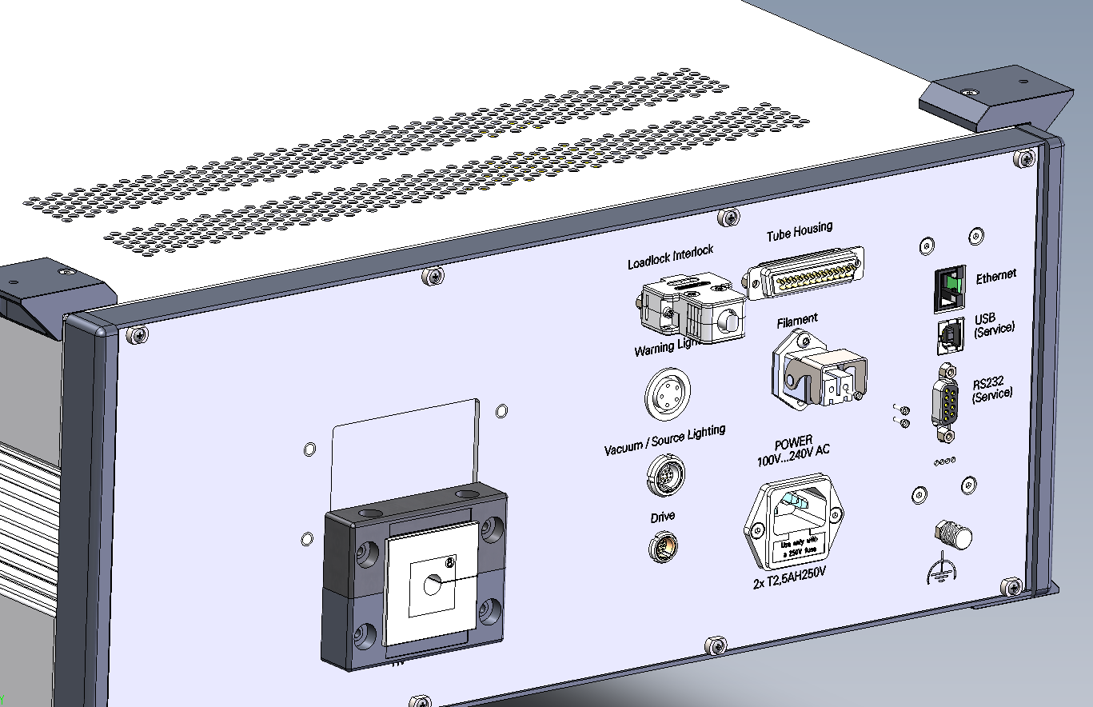
XTrace 2 – New safety features
Bruker Nano Analytics Division
Auto source insertion and retraction mode
SEM load lock integration
The polycapillary optic of the X-ray source can be automatically inserted and retracted using XTrace 2's motorized linear stage. The source can also be retracted when the SEM sample chamber is vented for sample change.
Status information of the SEM load lock chamber (open / closed) can be integrated in XTrace 2 security circuit for optimal X-ray safety purposes.
Designed for the integration of various SEM load lock chambers (from different SEM vendors)

Slide 12
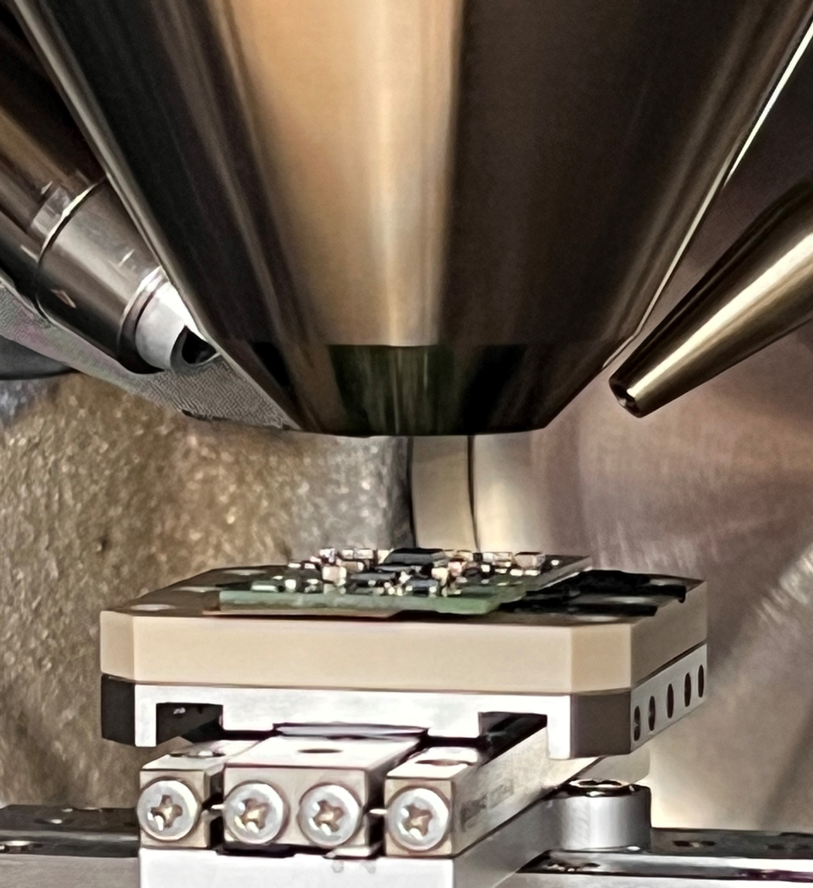
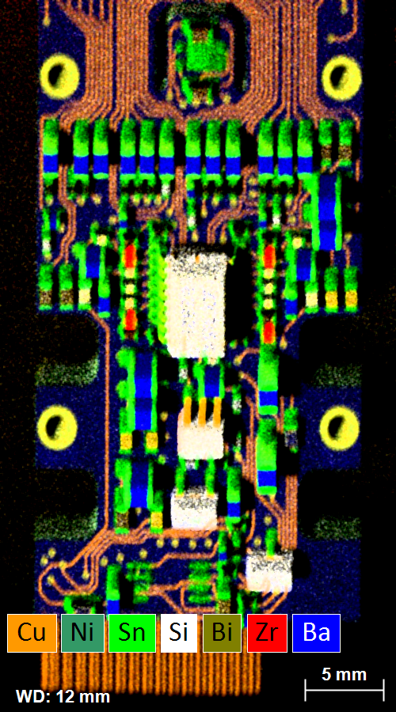
Fast elemental mapping of the electronic components on a Printed Circuit Board (PCB)
Bruker Nano Analytics Division
Recycling of electrical components, such as Printed Circuit Boards (PCBs) for the recovery of the elements present in them to compensate for current shortfalls in mining output.
High-speed micro-XRF on SEM can be used for the elemental analysis of electronic components at trace element sensitivity without any sample preparation required.
Elemental map of a PCB, acquired with micro-XRF on SEM, showing the elemental distribution of different circuit components.

Slide 13
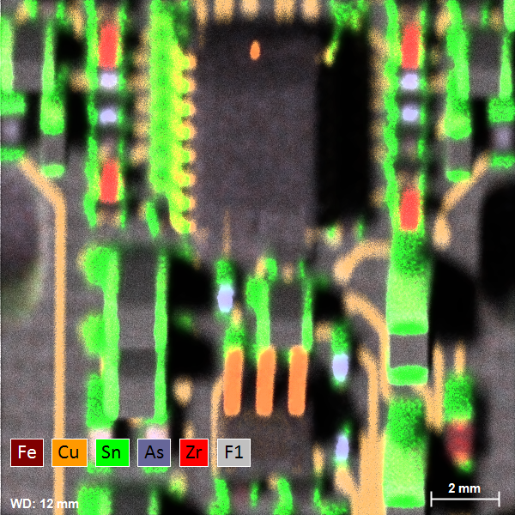
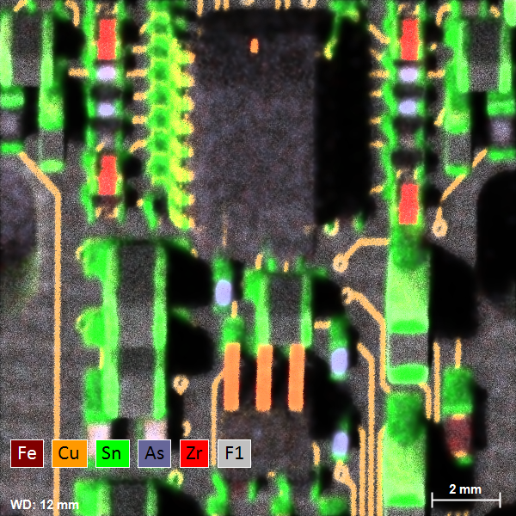
High-resolution elemental mapping of 3D features
Bruker Nano Analytics Division
The Aperture Management System (AMS) used in QUANTAX micro-XRF systems facilitates the high-resolution mapping of samples with 3D features, such as electronic components, at varying working distances.
Combined element intensity map, no AMS
Combined element intensity map, with AMS

Slide 14
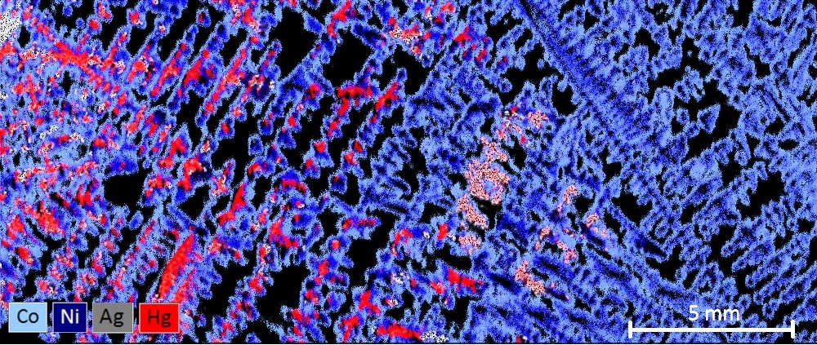
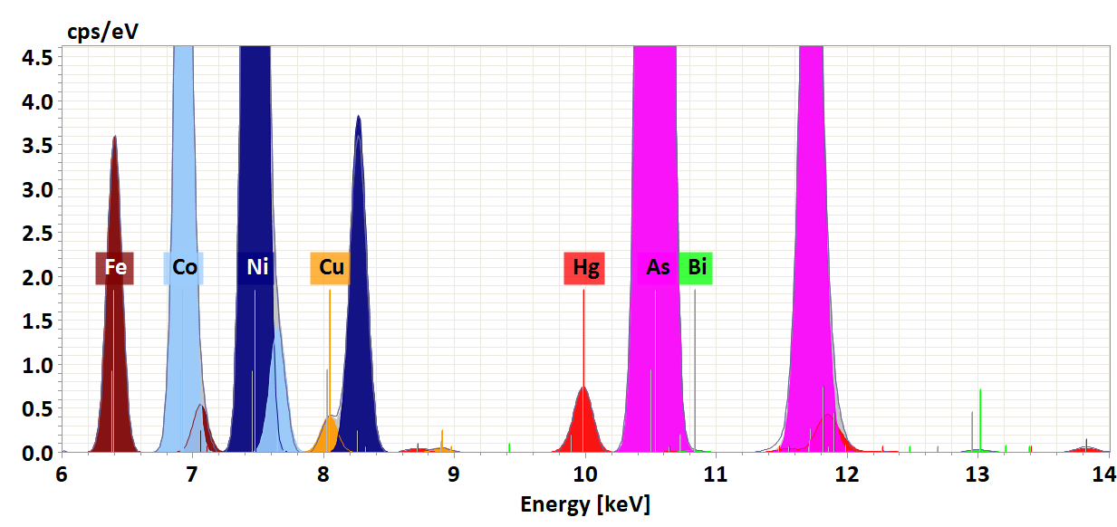
Identification and determination of the elements in ore at trace levels
Bruker Nano Analytics Division
Micro-XRF on SEM allows for the direct analysis of a cut rock sample with minimal sample preparation. Detailed mapping helps to quickly identify the elements present in the sample and their distribution.
In addition to identifying and determining the distribution of valuable elements, such as silver (Ag), copper (Cu), nickel (Ni), and cobalt (Co), toxic elements and those that can complicate mineral processing, such as arsenic (As) and mercury (Hg), can also be identified. Due to the low background and high signal-to-noise ratio even elements present at trace levels can be detected, in this example, mercury (Hg), bismuth (Bi), and copper (Cu).

Slide 15
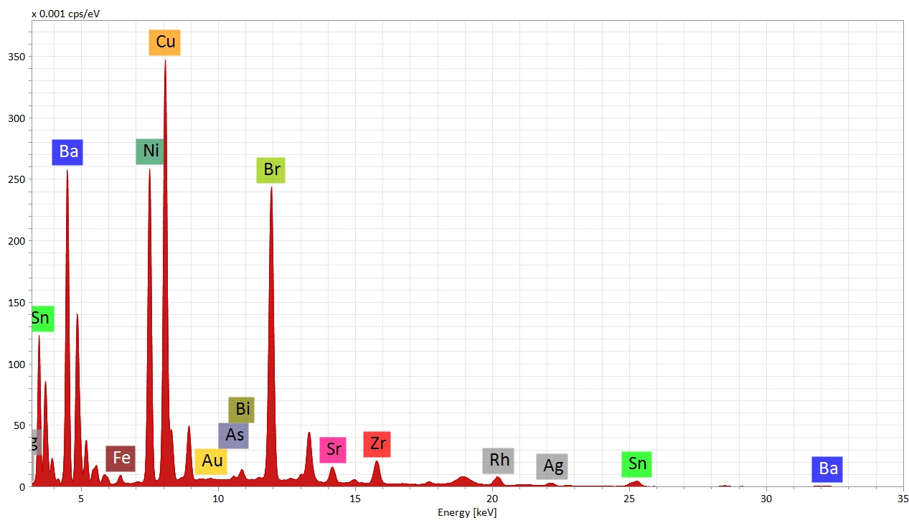
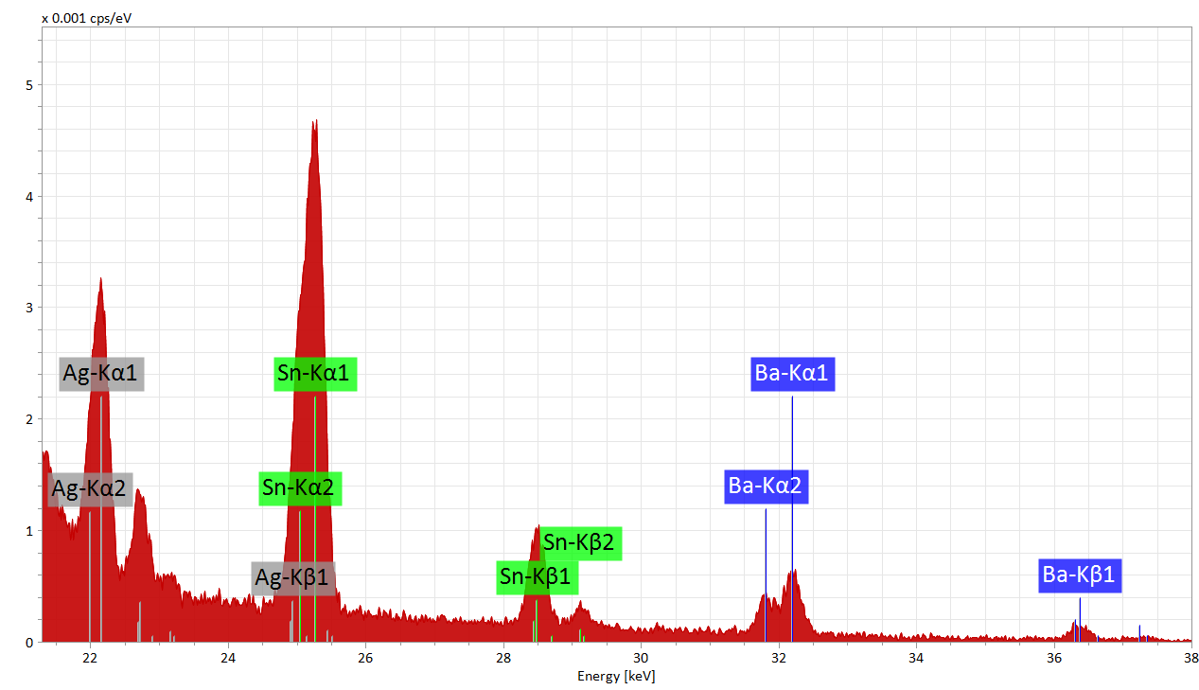
Accurate elemental analysis with high energy elemental lines
Bruker Nano Analytics Division
QUANTAX micro-XRF systems use a 50 kV X-ray source for the excitation to higher elemental energy lines, for example Ag Kα = 22.1 keV, Sn Kα = 25.3 keV and Ba Kα = 32.2 keV lines are all visible.
Full micro-XRF spectrum of a PCB showing how both major and trace elements can be detected using micro-XRF on SEM.
Zoomed spectrum energy range showing the detection of high energy elemental lines (higher than 20 keV)

Slide 16
info.bna@bruker.com

Slide 18
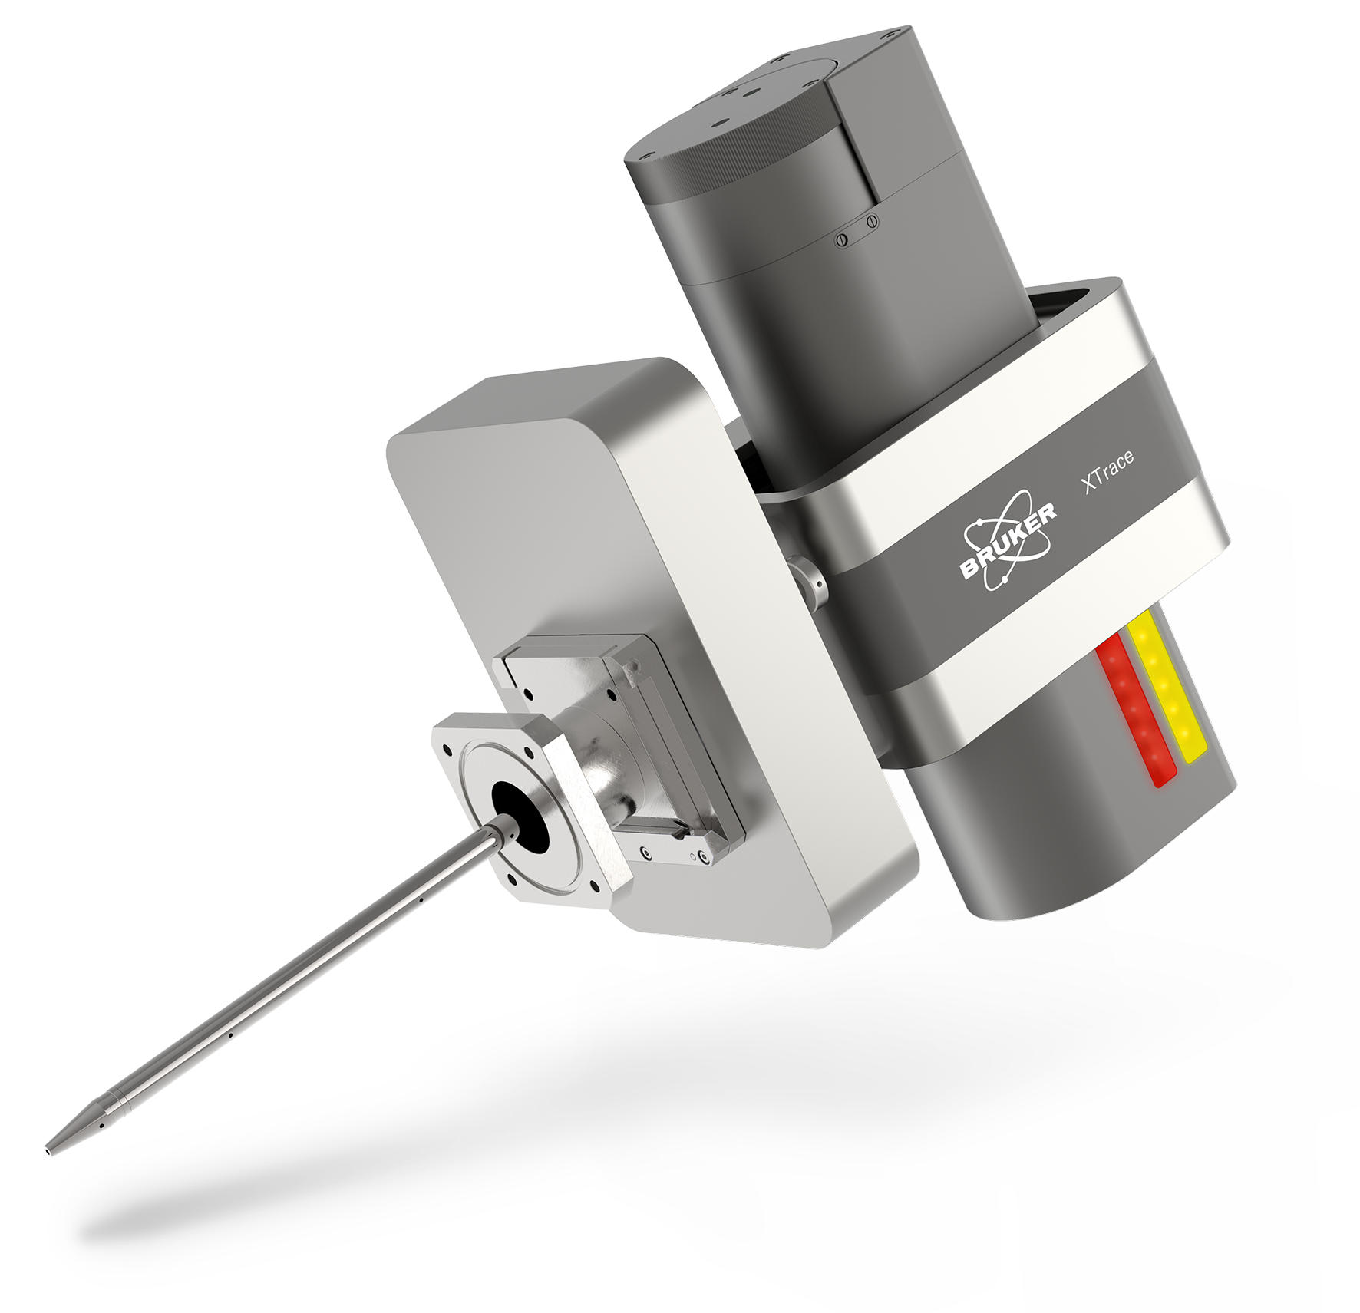
Comparison XTrace 2 vs. XTrace
Bruker Nano Analytics Division
XTrace 2
XTrace

Slide 19
Comparison XTrace 2 vs. XTrace
Bruker Nano Analytics Division
Parameter | XTrace 2 | XTrace
X-ray tube power | 50 W (50 kV, 1000 µA max.) | 30 W (50 kV, 600 µA max.)
Intensity on Cu (60 mm² EDS detector) | ~ 220 kcps | ~ 130 kcps
Linear stage operation | motorized | manually
X-ray optic auto retraction mode | Yes | No
Primary filter wheel operation | motorized | manually
Number of primary filters | 9 | 3
SEM load lock integration in security circuit | Yes | No
Ability to save custom linear stage positions | Yes | No
Ability to scan topographical samples | Yes (AMS) | No
Visual effects during running measurement | Yes | No
Automatic X-ray tube warmup procedure | Yes | No

Slide 20
Comparison XTrace 2 vs. competition
Bruker Nano Analytics Division
Parameter | XTrace 2 (BNA) | Xb SEMTM (IXRF) | Analytical benefits | Customer benefits
X-ray tube power | 50 W | 30 W | ~70 % higher count rates | Shorter acquisition time
Numbers of primary filters | 9 | 3 | Suppresses artefact peaks (diffraction, characteristic tube peaks) | Enhanced background reduction for improved sensitivity
Primary filter control | motorized | manual | - | Comfortable / intuitive usability by selecting the individual filters by SW
Ability to work with different spot sizes (FlexiSpot mode) | Yes | No | FlexiSpot mode provides a more representative analytical volume for quantification of inhomogeneous sample materials | Saves measuring time → instead of measuring various individual points, acquisition of only one spectra by using the larger spot
Auto retraction / insertion mode | Yes | No | 1. Meets SEM vendor requirements for keeping the pole piece area free 2. Avoids potential collisions with other equipment (XFlash® FlatQUAD, cathodoluminescence) | Available options: 1. after measurement 2. before venting 3. when closing ESPRIT
Ability to scan topographic samples | Yes | No | Keeps topographic specimens in focus over a certain range | Allows examination of topographic samples

